Slide 1
The European Centre for Modern Languages (ECML)
European Centre for Modern Languages of the Council of Europe
ECML
Centre européen pour les langues vivantes du Conseil de l‘Europe
CELV
Europäisches Fremdsprachenzentrum des Europarates
EFSZ

Slide 2
ECML: who we are and what we do
An enlarged Partial Agreement
of the Council of Europe with
33 member states;
founded in Graz, Austria in 1994
Mission
innovation in language learning and teaching; implementation of effective language education policies
Key target audience
decision-makers, researchers, teacher trainers, language teachers
4 year programmes
of international projects and bilateral training and consultancy
Our vision
A Europe committed to linguistic and cultural diversity, where the key role of quality language education in achieving intercultural dialogue, democratic citizenship and social cohesion is recognised and supported.

Slide 3
ECML Structure
http://www.ecml.at/Aboutus/AbouttheECML
ECML Governing Board
Appointed ministerial
representatives from each member state
adopt programmes of activities, monitors their implementation, oversees Centre‘s management
www.ecml.at/govboard
ECML National
Nominating Authorities
Agencies in each member state
linked to ministries
responsible for selecting
participants to the Centre‘s
activities
www.ecml.at/nomination
ECML National
Contact Point
National networks in language education
disseminate information and documentation on the Center‘s work
on a national level
www.ecml.at/contactpoints
Austrian Association for
the ECML (Verein EFSZ)
Representing Austrian authorities
provides and manages the Centre‘s infrastructure, develops synergies with partners in the region thereby creating added value within the host country
www.ecml.at/efsz
Notes:
The structure under which the ECML operates, allows the centre to work at multiple levels:
With experts in member states (as indicated in information on projects in previous slide)
With ministries (Governing Board)
With national institutions (National Nominating Authorities/National contact points as key dissemination partners
With host country in Austria through the Austrian Association
Moreover, the ECML also also works in partnership with the EU through a joint initiative entitled “INNOVATIVE METHODOLOGIES AND ASSESSMENT IN LANGUAGE LEARNING” – member states of both the EU and the ECML can request support from ECML experts in a) ICT for language teachers and b) how to relate language exams to the CEFR
The centre also reaches out to International non-governmental organisations with an interest in language education to ensure that it has access to the best expertise and the most up-to-date practice. It does so through the Professional network Forum of the ECML (change slide)

Slide 4
ECML projects
Répondent aux priorités en matière d'éducation aux langues identifiées par les Etats membres;
sont conduits par
une équipe d'experts
de différents Etats membres du CELV
Proposent des ateliers de formation destinés à des experts invités (de plus de 30 pays européens), lesquels agiront en tant que multiplicateurs et formeront à leur tour d'autres au sein de leurs institutions et réseaux
Produisent des ressources pratiques en ligne pour les professionnels en langues, adaptables à différents environnements d’apprentissage et librement disponibles sur
le site web du CELV
Address priorities
in language education identified by
member states;
are led by
a team of experts
from different
ECML member states
Provide training workshops for invited experts from over 30 European countries, who are expected to act as multipliers and to subsequently train others within their institutions and networks
Produce practical
online resources for language professionals, adaptable to
different learning
environments and
freely available
on the ECML website

Slide 5
ECML Thematic Areas

Slide 6
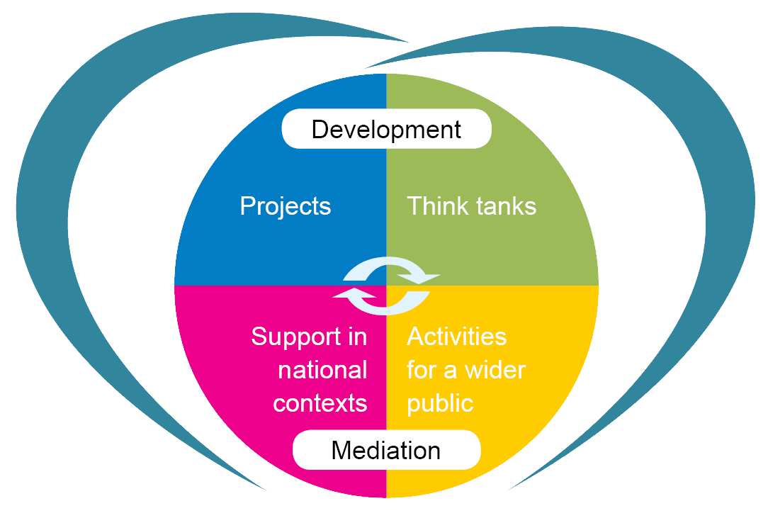
ECML programme 2016-2019
"Languages at the heart of learning"
Digital literacy
Adult migrants
Sign languages
Early language learning
CEFR implementation
Whole-school approaches to the language of schooling
Language in subject learning
Language teacher competences
Pathways for learning
Language learning environments
Action research
Training and consultancy
National support events
Colloquia/conferences
Colloquia/conferences

Slide 7
ECML training and consultancy for member states
Targeted, tailored support to address national challenges
Supporting Multilingual Classrooms*
Plurilingual education
Testing and Assessment (RELANG)*
Quality education in Romani
Quality assurance in language and citizenship courses
Language teacher education
Content and Language Integrated Learning
Use of ICT in support of language teaching and learning
Plurilingual and intercultural learning through mobility
Electronic European Language Portfolio
* in cooperation with the European Commission

Slide 8
ECML: a unique centre for language education http://www.ecml.at/
ECML key services
Future-proofing: innovative projects
Providing practical tools and resources: past projects
Celebrating languages: European Day of Languages
Informing:
newsletter;
website,
social media
Addressing national needs:
training and consultancy
Disseminating: mediation activities, conferences and national support events
Building networks and partnerships: international, European and national

Slide 9
www.ecml.at

Slide 11
Web pages dedicated to national ECML expertise - Example: Armenia

Slide 12
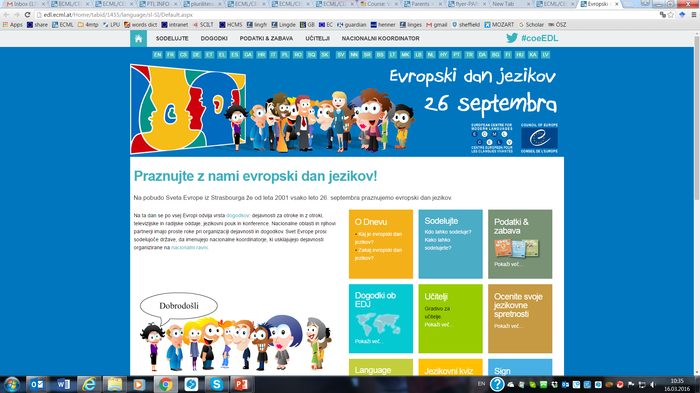
26 September – European Day of Languages

Slide 13
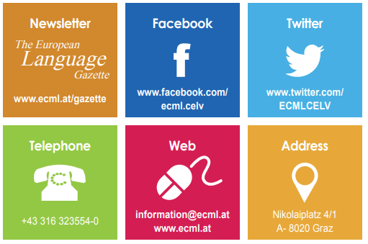
Keep in touch!

