Slide 1
The Call
Priorities and project teams

Slide 2
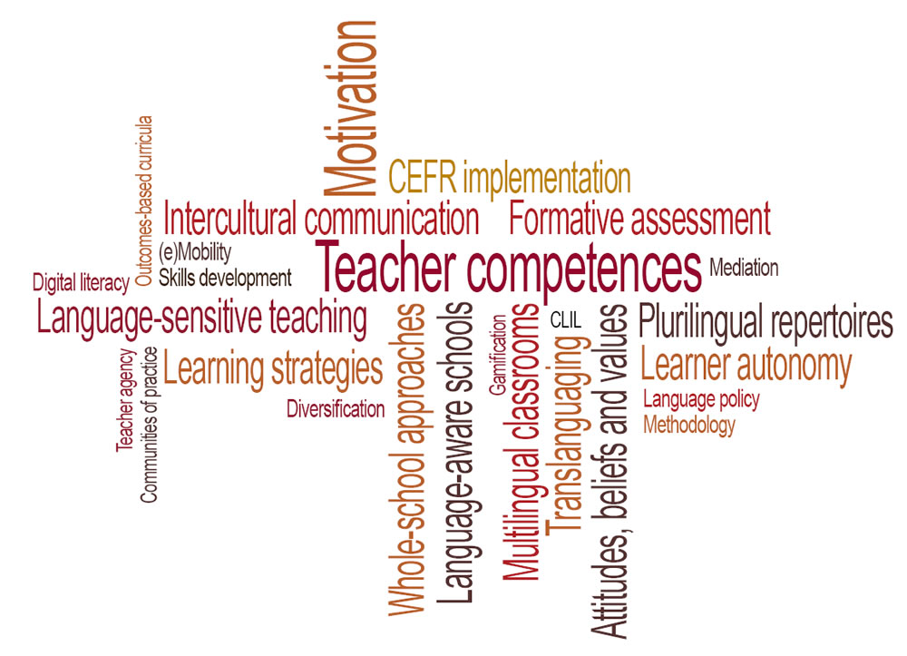
Priorities in ECML member states

Slide 3
Priority areas
Language professionals as agents of change
e.g. teacher development, learner autonomy
Considering and re-considering Council of Europe flagship resources
e.g. CEFR, CEFR Companion Volume, Competences for Democratic Culture
Foreign language learning and teaching in the spotlight
e.g. pluralistic approaches, the role of the first foreign language
Bi-/plurilingual education for a new decade
e.g. multilingual classrooms, languages across the curriculum
Organising language education
e.g. learning pathways, diversification of languages on offer

Slide 4
An ECML project team
4 experts from different ECML member states
Expertise in policy, theory, practice; understanding of needs and challenges in the chosen priority area
Coordinator
leads the team, manages the project, is responsible for project developments
Website correspondent
provides updates for the project website
Second language documentalist
ensures project documentation in the second working language
Communications person
communicates regularly about the project

