Slide 1
A roadmap for schools to support the language(s) of schooling
Key ideas of the ROADMAP
and benefits for the school
www.ecml.at/roadmapforschools

Slide 2
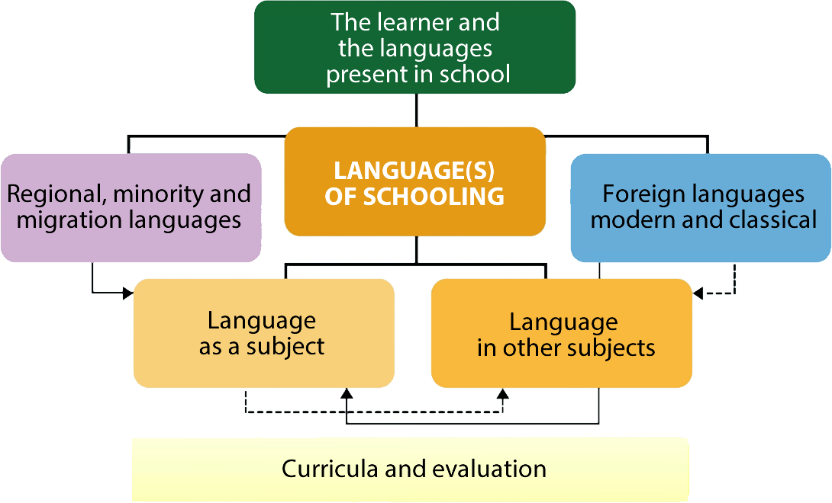
Platform of resources and references for plurilingual and intercultural education
https://www.coe.int/en/web/platform-plurilingual-intercultural-language-education/home
Notes:
Here you can talk shortly about the definition of the language(s) of schooling: “The language(s) used in teaching the subject. It is the dominant language of instruction in school which is normally the main national or regional language”. (You can get more information by following the given link)

Slide 3
Scope and aims of the ROADMAP
To foster linguistic and cognitive abilities of ALL students using a whole-school approach
To help schools identify and address existing needs
To provide tools to identify these needs
To provide material to help schools to improve their practice

Slide 4
Stakeholders
Who should take part in the ROADMAP project?
Headteachers
Teachers
Non-teaching staff
Students
Parents
Notes:
These stakeholders have an active role in identifying the schools strengths and areas of development.

Slide 5
Nine areas of self-assessment for the school
Awareness of language dimension
Developing language knowledge and skills
Metalinguistic awareness
Role of languages in learning
Attitudes towards languages
Promoting informal language learning
Language resources at school
Orienting new students and families
Professional development
Each area is subdivided into dimensions with corresponding statements in the online survey.
Notes:
The roadmap focuses on these areas to help schools develop a strategy to support language(s) of schooling. See the Coordinator’s guide to get more information regarding the scope of the areas.

Slide 6
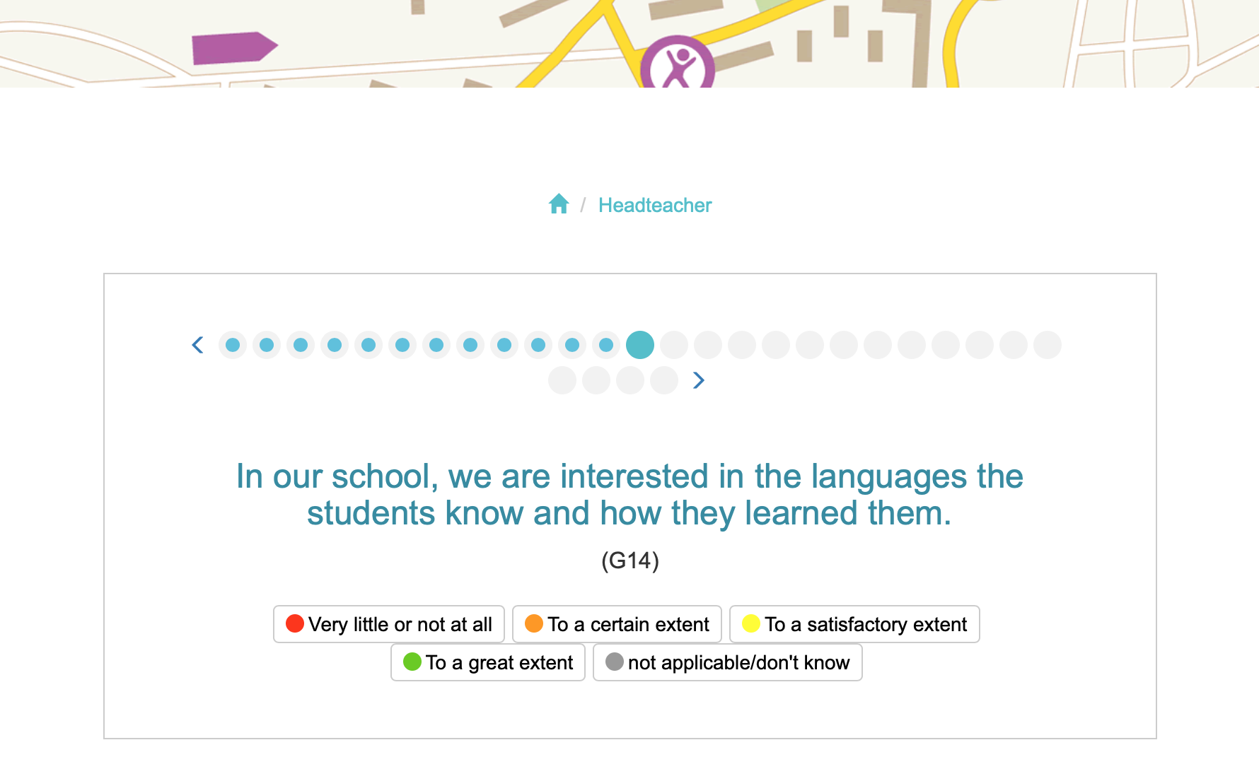
The ROADMAP online self-assessment tool
Example of the survey for the headteacher: survey participants are requested to respond to statements.
Notes:
The roadmap is a self-assessment tool for schools. It contains 5 different surveys (for each stakeholder-group) presented online. It takes 10-30 minutes to fill out for each person taking the survey. The survey is most time-consuming for the teachers and headteachers but much less for the other three groups.
The different views of the stakeholders on the same dimension are considered in the survey. This allows the school not only to get a whole-school assessment but also to become aware of possible discrepancies regarding the same area. For example, if in the area "Awareness of language dimension" the headteacher’s opinion differs strongly from the opinion of the students, it is recommended to think about the results.

Slide 7
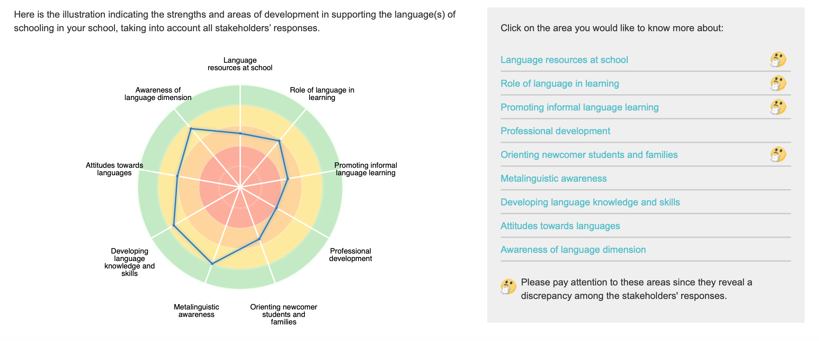
Results for the school
Example of the presentation of the survey results of a school.
Notes:
Once the survey is closed, the school-team analyses the results submitted by the coordinator. The results of the school are presented in different ways. The overall results are presented with a spidergram. The strengths and areas of development are shown with a scale of colours. On the right, the nine areas appean: the discrepancies between stakeholders are marked with a "thinking smiley". They require specific attention.

Slide 8
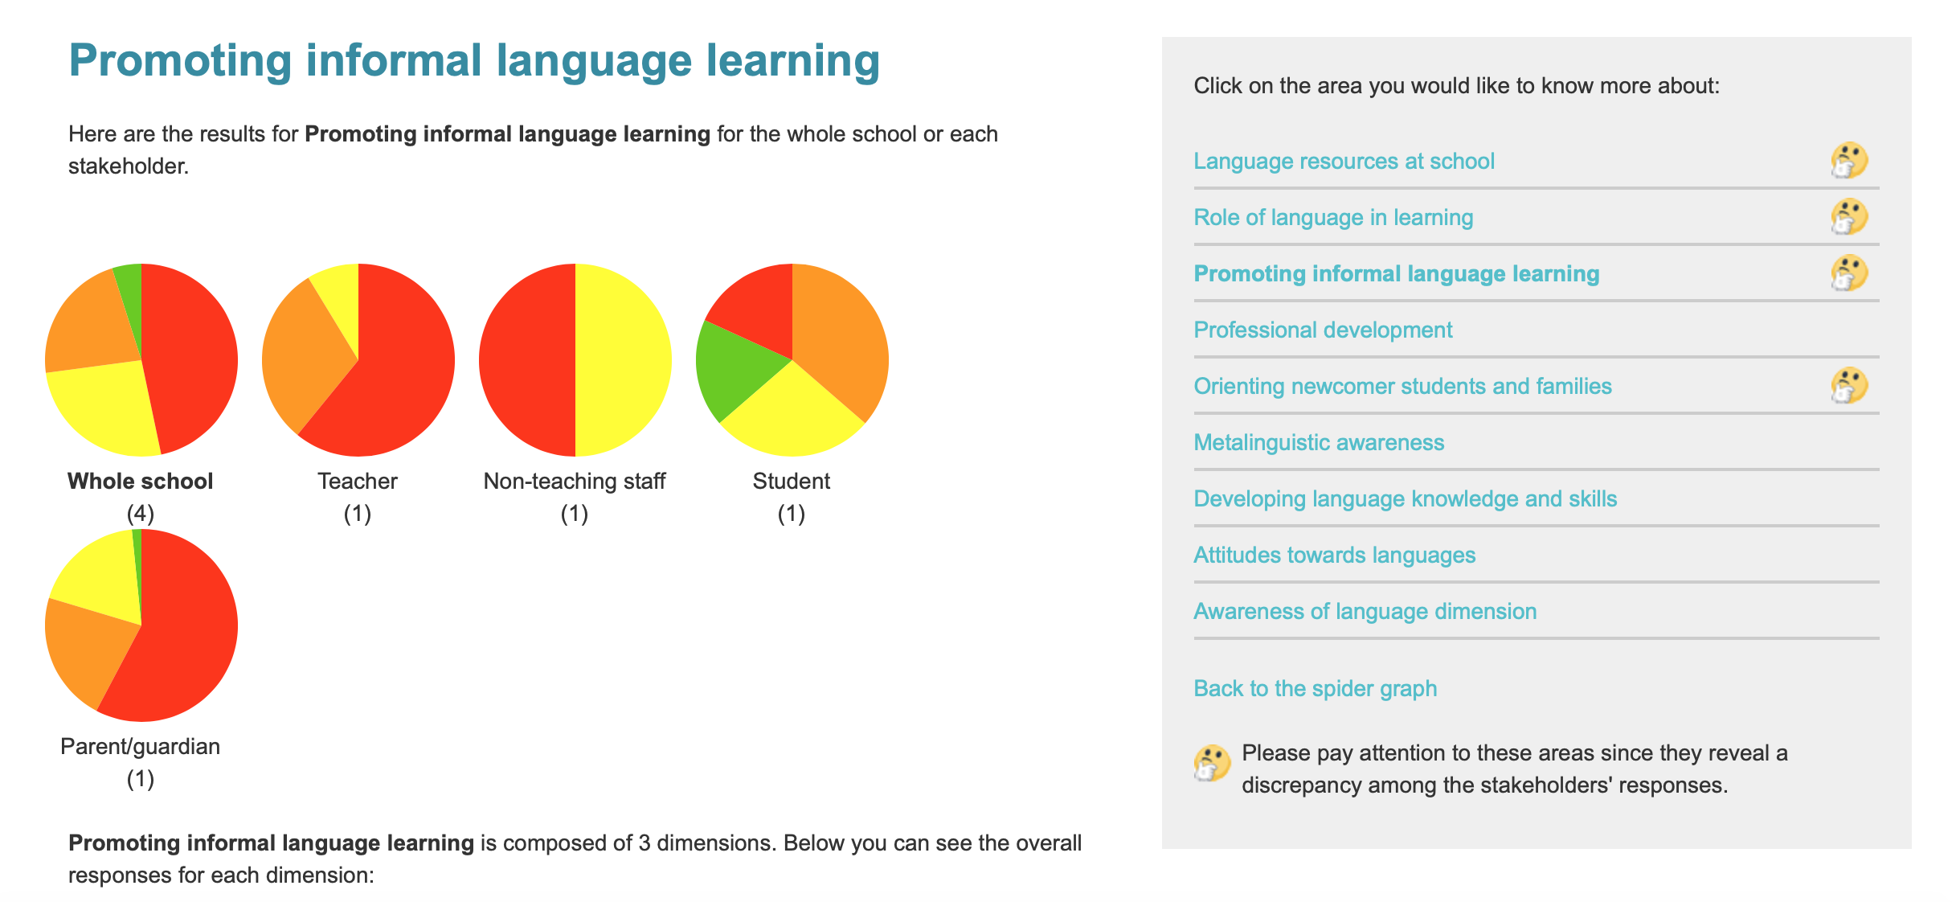
Results for each area
The survey results are presented for the school as a whole and for each of the individual stakeholder groups.
Notes:
The navigation brings the user to the next level of analysis, where the results for a chosen area are shown for each stakeholder-group.

Slide 9
Promising practices
The website presenting the survey results of the school offers links to a wide range of promising practices and ideas for activities relevant for further development in specific areas.
The school can click on an area of development and gain inspiration from practices implemented by schools across Europe and beyond.

Slide 10
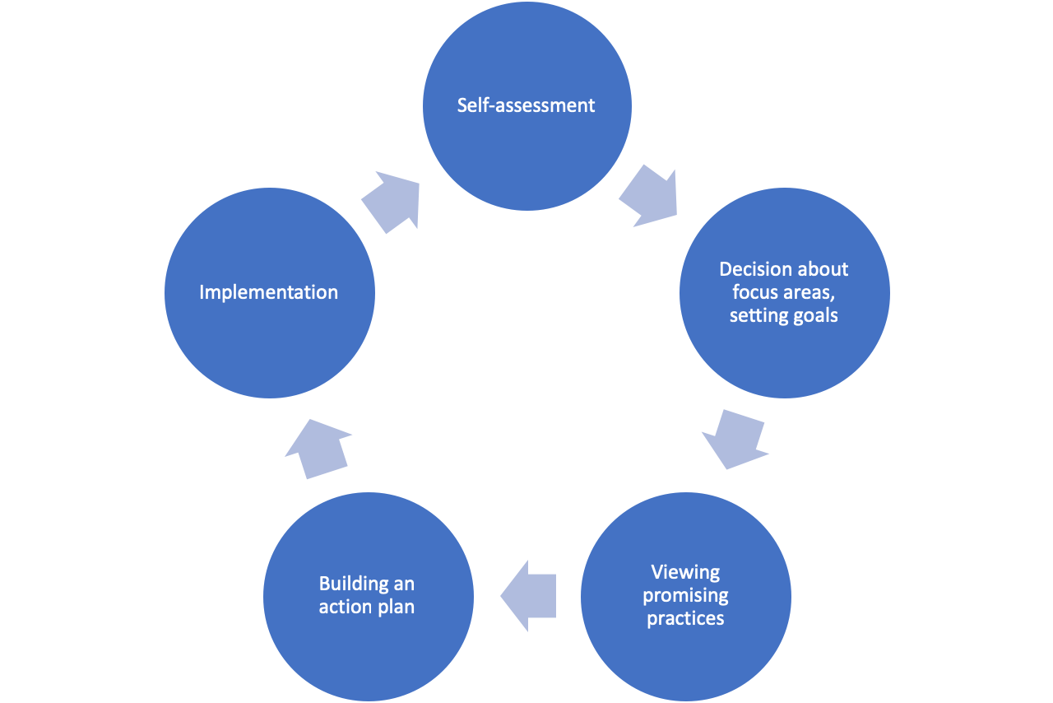
QUALITY CIRCLE
The ROADMAP project supports the idea that quality development is based on self-reflection, collaboration and targeted action.
Notes:
The next step is to build or use a quality circle
It is possible to assess the actions put in place by using the roadmap a second time.
Developments need time, so it is good to have a plan for at least one year.
Assessment is important for sustainability. Some promising practices might not work in the local contexts and should be discarded. Others might change things efficiently and should therefore become part of the regular school curriculum.

Slide 11
Thank you for your attention

