Slide 1
Action research communities for language teachers
www.ecml.at/actionresearch

Slide 2
Project overview
This project is about making techniques for action research widely available to language teachers through the establishment of a community of practice, bringing together newly qualified teachers, experienced teachers, teacher trainers and university researchers.

Slide 3
Project aims
To strengthen professional networks by linking academic expertise on action research & good practice in the language classroom
To contribute to improvements in language education by giving teachers across Europe better access to action research & new perspectives on languages methodologies
To enable teachers to reflect on their practice & to propose and test innovations within a community of practice

Slide 4
Project objectives
To design action research tools which help to improve the quality of teaching & foster dialogue between teachers in different sectors
To demonstrate how research can feed into practice & practice into research
To show how undertaking action research is beneficial to teachers & learners by creating a set of success stories in different languages
To create European models for peer learning activities which can be implemented at school/national level

Slide 5
Project team
Christine Lechner, Pädagogische Hochschule Tirol
Co-ordinator - Teacher educator at initial & CPD level. English + AR
Brynhildur Ragnarsdóttir, Language Centre, Reykjavik
Web-site correspondent - Head of a nationwide language centre that has supported language acquisition & language teaching via online distance learning since 2002.
Angela Gallagher-Brett, SOAS, University of London
Communications person - Languages teacher, Applied Linguist, Head of learning and teaching development at university
Tita Mihaiu, Centrul pentru formarea continuă în limba germană (CPD)
Second language documentalist - German teacher & organiser of CPD for German teachers

Slide 6
Project team
Associate partners
Renata Zanin, University of Bolzano
Teacher educator at ITE & CPD level at trilingual university, Networking to Euregio Regio
Jim Murphy - CALL expert from St. Johns, Newfoundland
Anita Konrad, Pädagogische Hochschule Tirol
German specialist
Melanie Steiner, Pädagogische Hochschule Tirol
German Specialist
Marianne Jacquin, Teacher training institute (IUFE), University of Geneva, Switzerland

Slide 7
Project first steps
Networking & discussions at regional levels of partners
First workshop during International Week at Pedagogical University Tirol
To open up discussions on quality and enhancement in teaching at tertiary level across Europe
Action Research Workshop for German teachers in Sibiu / Hermannstadt October 2016
To introduce action research tools
To plan & develop collaborative action research projects
Action Research Workshop in Graz November 2016
To foster dialogue about language teaching practice in ECML countries
To introduce action research tools
To plan and develop collaborative action research projects with outputs due in Spring 2017

Slide 8
Sibiu / Hermannstadt template for 3-day Action research workshop : Day 1
Getting into action research | Content-pack | Aims
Opening & introductions Activity finding out what we have in common | Learning about target-language country culture Austria | To open up to working together, challenging ideas and developing teaching
What do I already know about the theme? | Getting into the theme Do we all have the same ideas when we think of Austria? How to be an Austrian? | To clarify that there are different approaches to a topic & different ideas
Analytic discourse | Posters on teaching about the target language country: my status quo | To get to know each other & to demonstrate an action research tool To show that discussions about teaching aren’t always critical, comparative…
From analytic discourse to perspectives on themes & the ARC Project within ECML programmes | Current (opposing) trends in cultural studies & intercultural learning | To bring the strands together & introduce the project and the ECML To demonstrate a feedback cycle

Slide 9
Sibiu / Hermannstadt template for 3-day Action research workshop: Day 2
Getting into action research | Content-pack | Aims
Welcome & arrival activity Different ideas & perspectives Comments on feedback from Day 1 & procedures for Days 2 & 3 | True or not true? Which of three stories is not an Austrian story? | To bring group back together To continue with multi-perspective thinking To demonstrate taking feedback on board
Some ideas about action research |  | To provide a theoretical framework
 | Input on theme in form of islands Aspects of life in Austria Regions Literature from Austria My life in my environment Thinking about stereotypes | To provide content for development of joint lessons
Finding themes & groups for lesson development Short evaluation: The Wailing Wall | Which materials provided were useful? | To ensure that joint planning will work in a concrete way To demonstrate a feedback cycle

Slide 10
Sibiu / Hermannstadt template for 3-day Action research workshop: Day 3
Getting into action research | Content-pack | Aims
Welcome & comments on evaluation |  | To bring group back together To demonstrate taking feedback on board
Ideas on joint planning Reference to learning study procedures Group diamond activity to find a common vision | Our vision for good lessons about the cultures of target-language countries | To open up ideas for joint planning/ joint visions
Developing a lesson together | Lessons on the culture of a target-language country | To put joint planning/ joint visions into practice
Presentations & conclusions “What is different now”? Expectations how the lesson will work in the different classes Clarifying reports Official written evaluation & paper-ball evaluation | Lesson formats on the culture of a target-language country | To stimulate interest for the work of others To demonstrate a feedback cycle

Slide 11
Graz workshop programme
Thursday, 10.11.2016
Welcome activity, ECML presentation
Project team – Introductions Getting into the theme: Activity & presentation
My teaching: status quo - Analytic Discourse
Some Action Research Concepts “Walk & talk” - focussed interactive discussions
Action research tools
Conclusions for the day, participant feedback + invitation to first thoughts for action plan on Day 2

Slide 12
Graz workshop programme
Friday, 11.11.2016
Action research project planning 15-minute input on co-operative planning
Language teaching online – Pedagogical and logistical challenges
Finishing plan – setting up contact with groups Participant feedback Conclusions
Guided city walking tour, sponsored by the Austrian association of the ECML

Slide 13
Graz workshop: our languages tree
Tree representing the languages spoken by workshop participants

Slide 14
Graz workshop mini-projects
A research question
Rationale & theory base
Project steps
Carrying out teaching
2-3 instruments
Reflection & action
Conclusions & outlook
Report for whole workshop group by
mid-March
Online publication: report, presentation,
research paper

Slide 15
Graz workshop - mini-projects: research topics
Does an explicit focus on critical thinking skills in our lesson planning and instruction enable students to engage in critical thinking? Participating countries: Albania, Netherlands, Malta, Latvia
How can pupils’ language skills be enhanced by using news media and Facebook sharing in language teaching? Participating countries: Croatia, Iceland
Breaking barriers: Can we identify barriers for professional learning English as a second language at university level? Participating countries: Armenia, France
What is the role of the teacher in university student-centred activities? Participating countries: Finnland, France
How does teaching vocabulary learning strategies contribute to learner autonomy in CLIL & MFL classrooms? Participating countries: Ireland
Wie kann erreicht werden, dass die Kinder im Unterricht in der Zielsprache Deutsch sprechen? Participating countries: Liechtenstein, Lithuania, Romania

Slide 16
Graz workshop – mini-projects: research topics
Using the European Portfolio of Student Teachers of Languages (EPOSTL) as a self-reflection tool for improving pre- and in-service teachers’ competences. Participating countries: Bosnia and Herzegovina, Estonia, Greece
Challenges of CLIL teachers Intercultural competences through a student- based project. Participating countries: Czech Republic, Poland
CLIL in secondary vocational schools seen through students’ perspectives. Participating countries: „The former Yugoslav Republic of Macedonia“, Serbia
Intercultural competences through a student-based project. Participating countries: Austria, Denmark, Montenegro
The teacher as co-constructor of knowledge Participating countries: Bulgaria, Switzerland, Germany, Norway, Slovenia

Slide 17
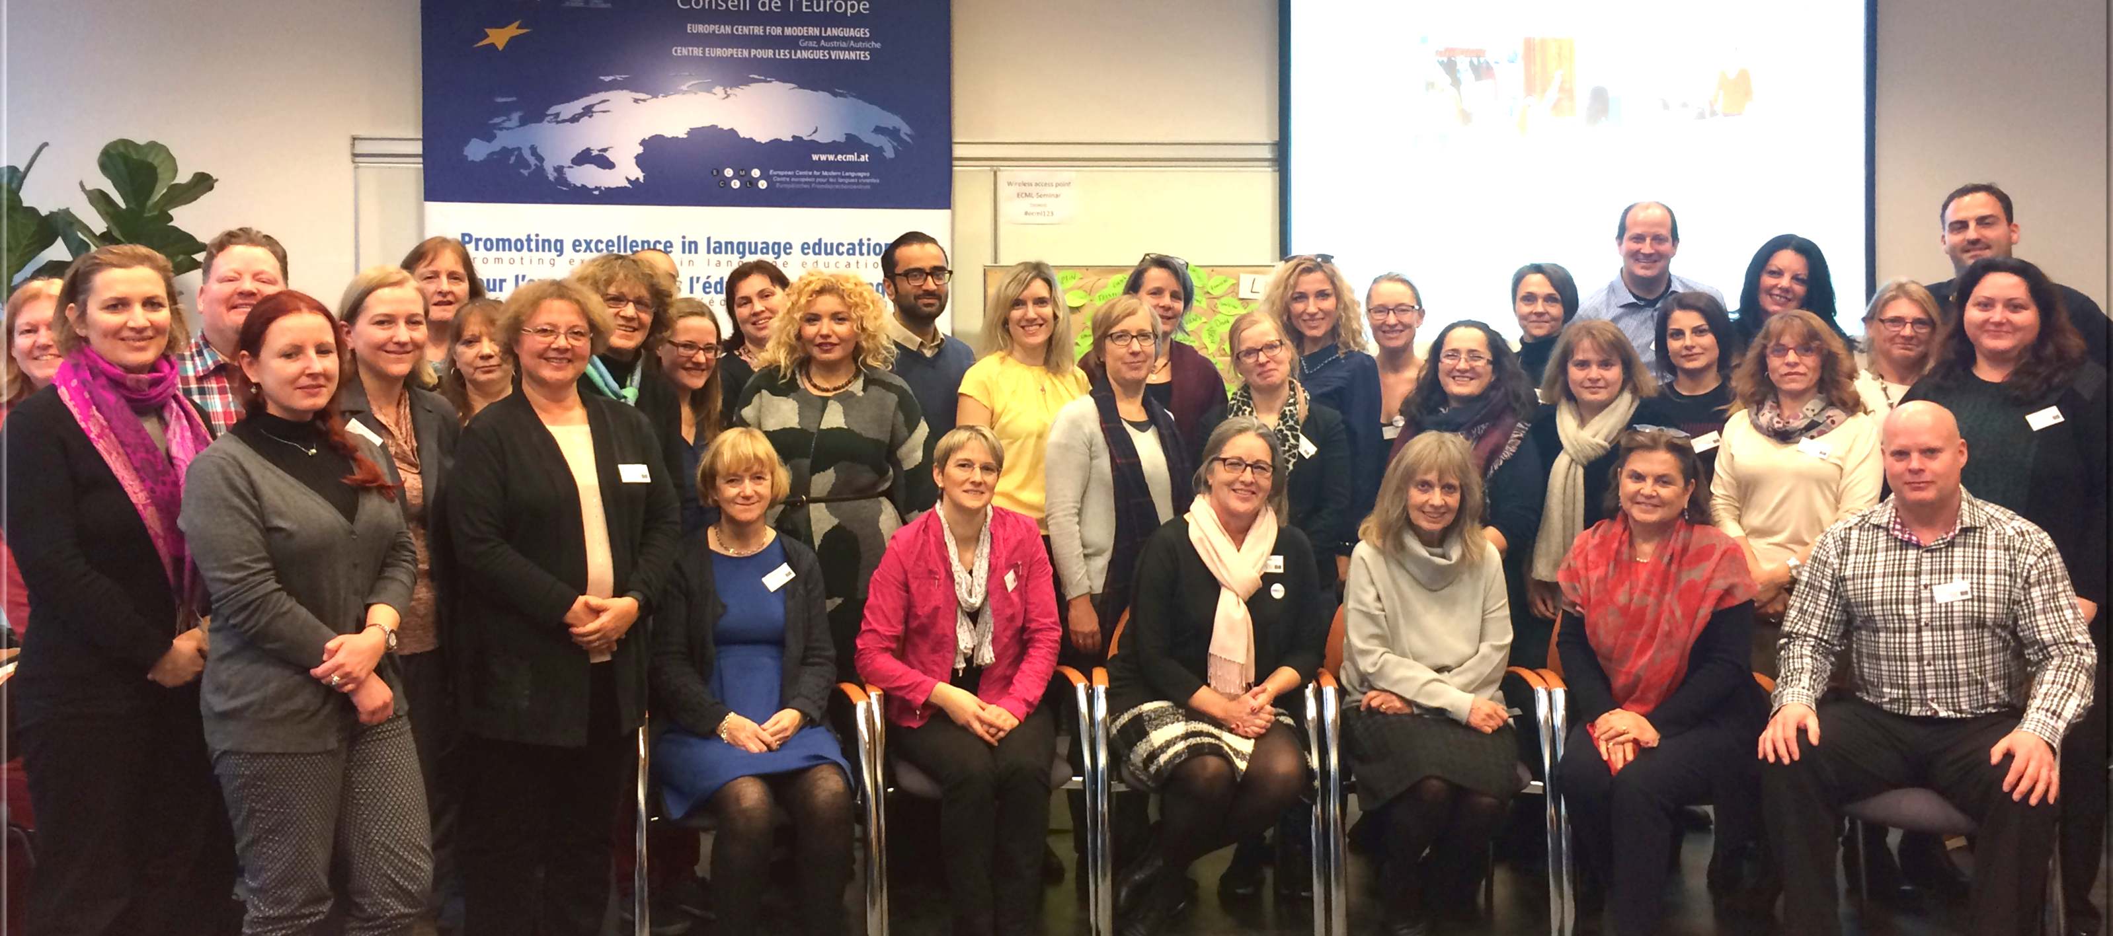
Graz workshop participants

Slide 18
Next steps
Workshop participants to develop their collaborative action research projects and conduct research in their classrooms
Participants to report on action research project outcomes in March 2017 & success stories to be disseminated
Project team to explore and develop synergies and links with other ECML projects
Project team to develop guidelines for action research networking strategies and formats for training courses to improve classroom practice by linking quality strategies to practical Action research approaches

Slide 19
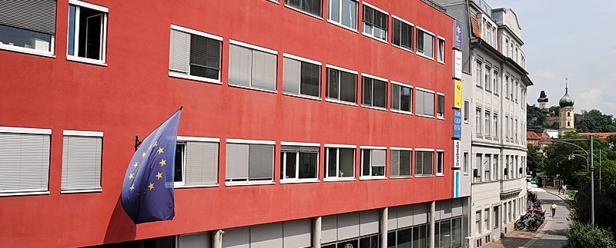
Project website Action research communities for language teachers http://www.ecml.at/actionresearch

