Slide 1
Online Survey
a quick way to collect responses to set questions
can be used for feedback after classes or to stimulate reflection
sometimes integrated in other tools or applications (e.g. conferencing, websites, sent as email attachments)

Slide 2
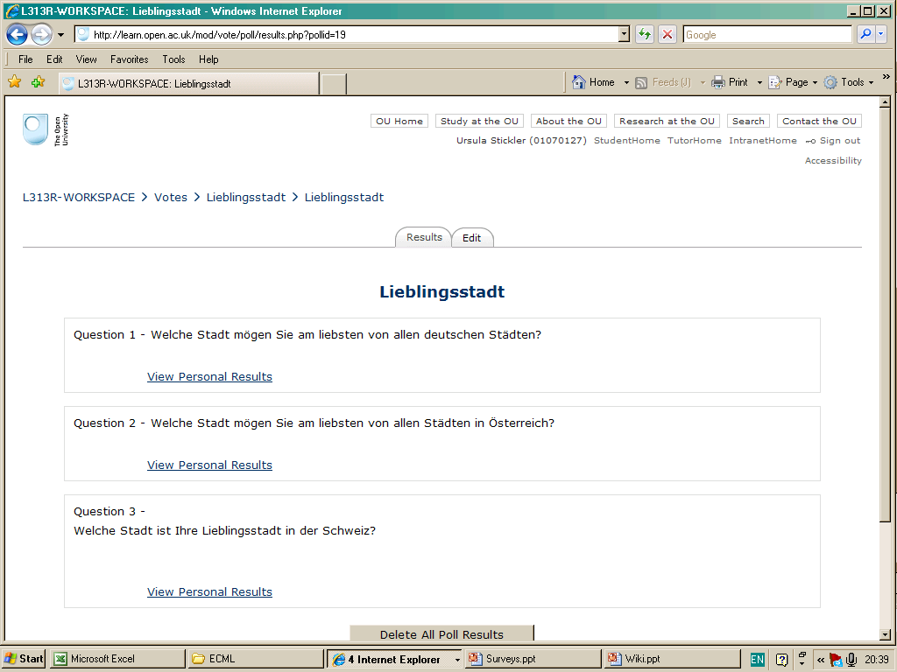
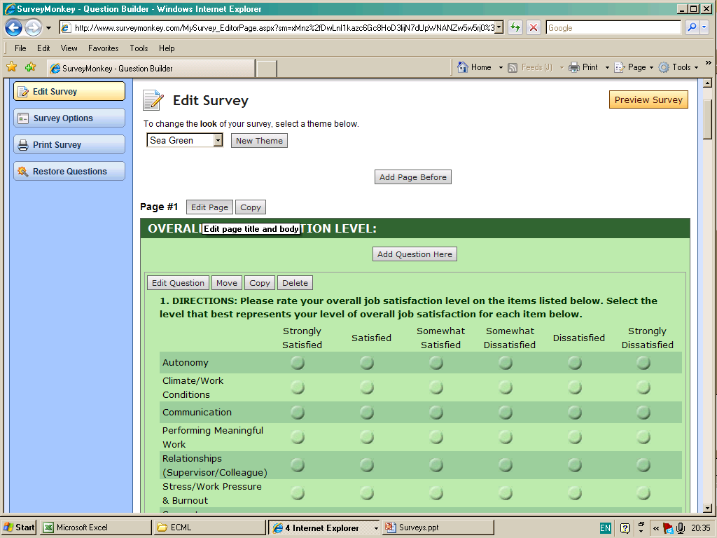
Examples
Moodle integrated survey: Poll
surveymonkey.com – free for small scale use
Online survey in newspaper

