Slide 1
Podcasting
Enormous variety of podcasts available
Authentic listening materials, and topics that are of interest to your students
Podcasts by teachers and by students
Podcast
Notes:
What is it? Audio or video content you can subscribe to and download to your portable media player or computer.
Why use it? Four main uses: Language learning podcasts, “authentic” materials, student podcasting, podcasts by teachers.

Slide 2
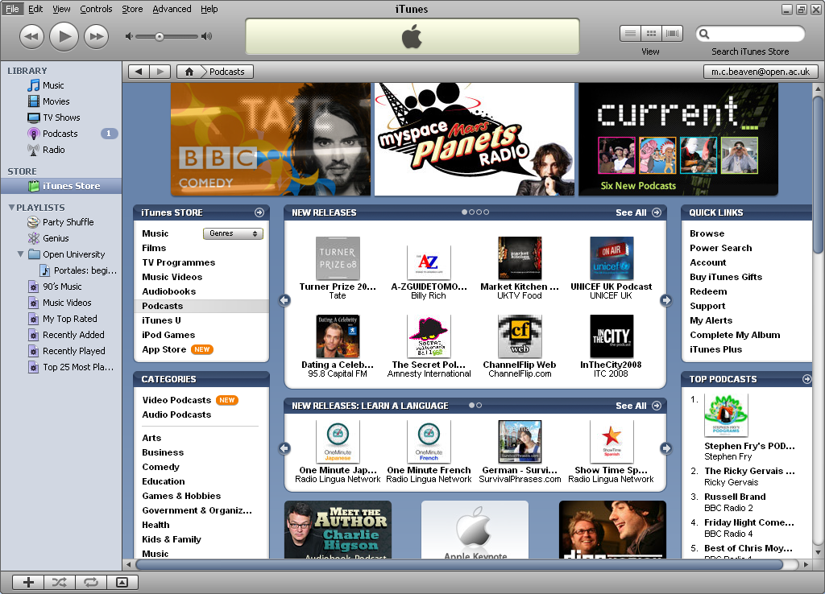
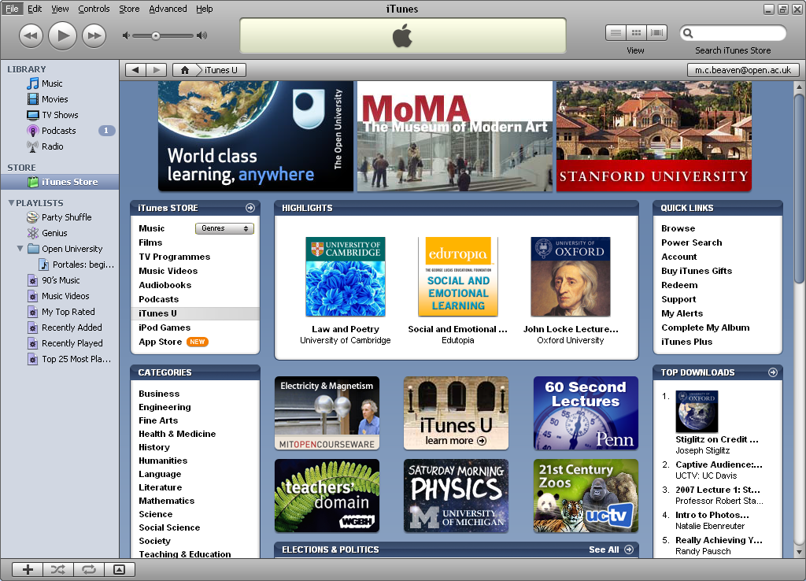
Examples of free podcasts
Podcasts for language learning
Podcasts for the general public
iTunes U
Notes:
What is it? Audio or video content you can subscribe to and download to your portable media player or computer.
Why use it? Four main uses: Language learning podcasts, “authentic” materials, student podcasting, podcasts by teachers.

