Slide 1
Glossary
Allows users to create and maintain a list of definitions, like a dictionary
Entries can be searched or browsed by category, date or author
Allows learners to collaboratively create their own course glossary
The glossary can be used for any alphabetical listings
Automatically highlights glossary words in associated texts and links to definition

Slide 2
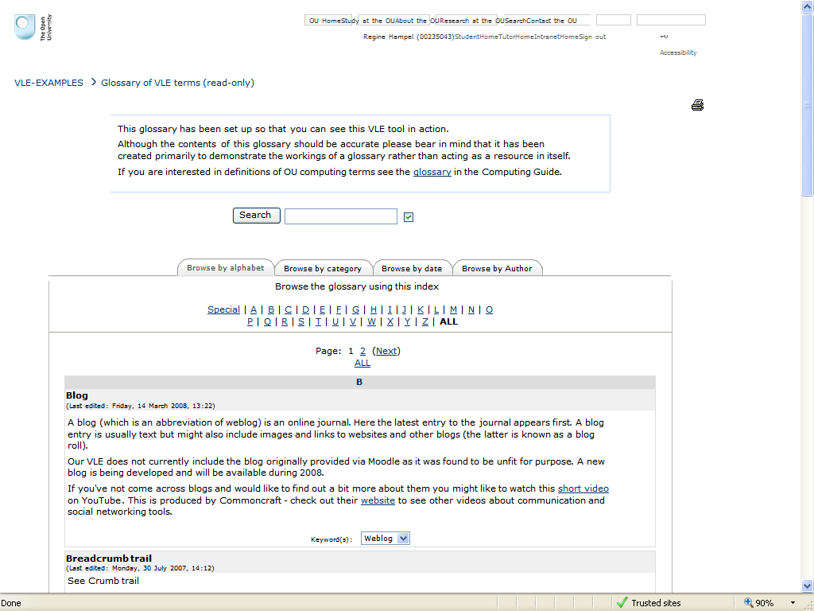
Examples of glossaries
defines or translates highlighted words
lists definitions

