Slide 1
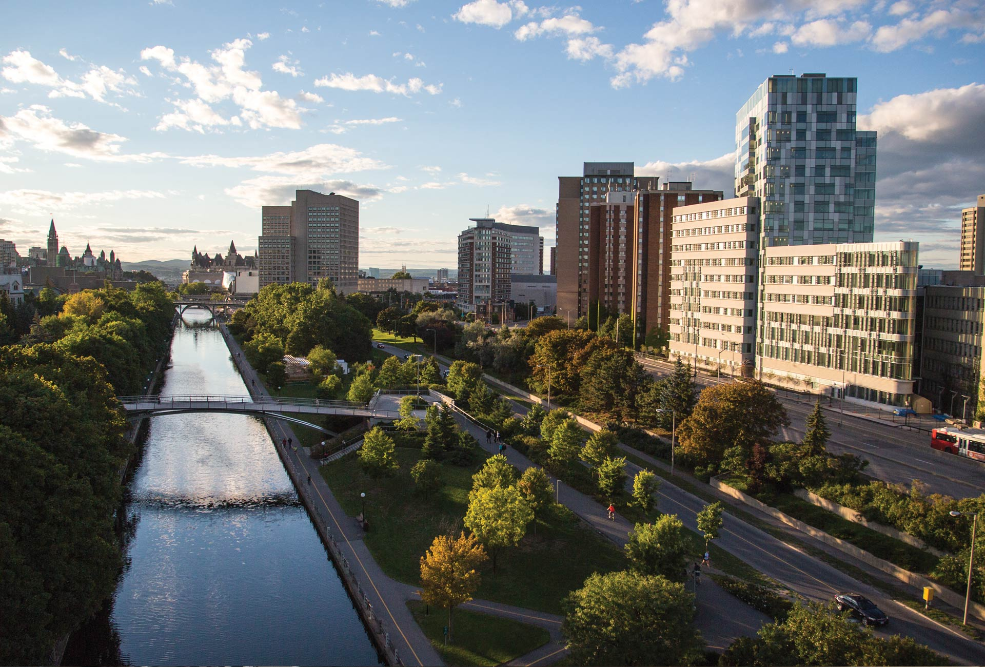
Institut des langues officielles et du bilinguisme (ILOB)
Professional Network Forum, Graz 2015
ilob.uOttawa.ca

Slide 2
CCERBAL within OLBI
Research expertise, research networks:
Second language learning, teaching and testing
Linguistic and social aspects of individual and societal bilingualism
Language policy and planning, and the politics of language
OLBI (CCERBAL) acting as the ECML contact point in Canada; founding member of PNF

Slide 3
Partners’ highlights
Events:
CCERBAL biannual conference
Literacies and autonomy of Advanced Language Learners (April 24-25, 2014)
Guess speakers:
Heidi Byrnes (Georgetown); Nicole Poteau (Strasbourg)
Guess symposium of the Research Chair in CALL
Marie-Josée Hamel (Ottawa)
OLBI Research Forums
D. Cousineau Pilot project with CEFR/DELF (Oct. 2014)

Slide 4
Partners’ highlights
Publications:
50 Years of Official Bilingualism. Challenges, analyses and testimonies (2014)
R. Clément & P. Foucher
C-ECML publication. Collaboration by Canadian experts to ECML 3rd and 4th programs (in press)
H. Lemoine, R. Clément & M.-J. Hamel
Literacies and Autonomy of Advanced Language Learners
Cahiers de l’ILOB, vol. 7 (Spring 2015)

Slide 5
Partners’ highlights
Research groups for CCERBAL:
GRILT: Groupe interdisciplinaire de recherche en langues et technologies (Research Chair in CALL initiative)
LARG: Language assessment research group (new testing expert)
PIRG: Post-secondary immersion research group
GRIGL: Groupe de recherche interdisciplinaire en gestion des langues
Teaching:
MA in Bilingualism Studies (first cohort 2014-2015)
https://olbi.uottawa.ca/programs/masterofarts
Immersion Studies
http://immersion.uottawa.ca/fr
Intensive Programs (English and French)
https://olbi.uottawa.ca/intensive-programs

Slide 6
Partners’ highlights
Forthcoming:
World Congress of Modern Languages (March 26-28, 2015, Niagara Falls)
Invited symposiums:
C-ECML
Canadian experts collaborating on ECML 4th program projects
CCERBAL
Best practices in language teaching and testing
Sarah Breslin’s visit to Canada (March 2015)
WCML; Ministries of Education, Foreign Affairs, Canadian Heritage; OISE; OLBI
Conférence de l’association internationale des commissaires de langue (AICL, May 2015)

Slide 7
Burning issues (3rd ECML Program)
Themes that resonate within the Canadian language education context:
Training the trainers in technology mediated language learning
CEFR integration in language learning curriculums (K-12)
Pursuit of language training until high school graduation and in post-secondary education (motivation; L2 course offering)
Introduction of a 3rd language (earlier in the curriculum)
Bilingualism and learners with learning difficulties
Immigration and the learning of the second official language

Slide 8
Viele danke!
Marie-Josée Hamel
Director of Research (CCERBAL)
Official Languages and Bilingualism Institute
marie-josee.hamel@uottawa.ca
University of Ottawa
70 Laurier Av.
Ottawa, ON
CANADA K1N 6N5

